Slide 1
DEG-KDA AD Analysis
Eric Zhuang

Slide 2
General Workflow
MAST Analysis (DEGs)
KDA Analysis
Interpretation

Slide 3
MAST Analysis and Results

Slide 4
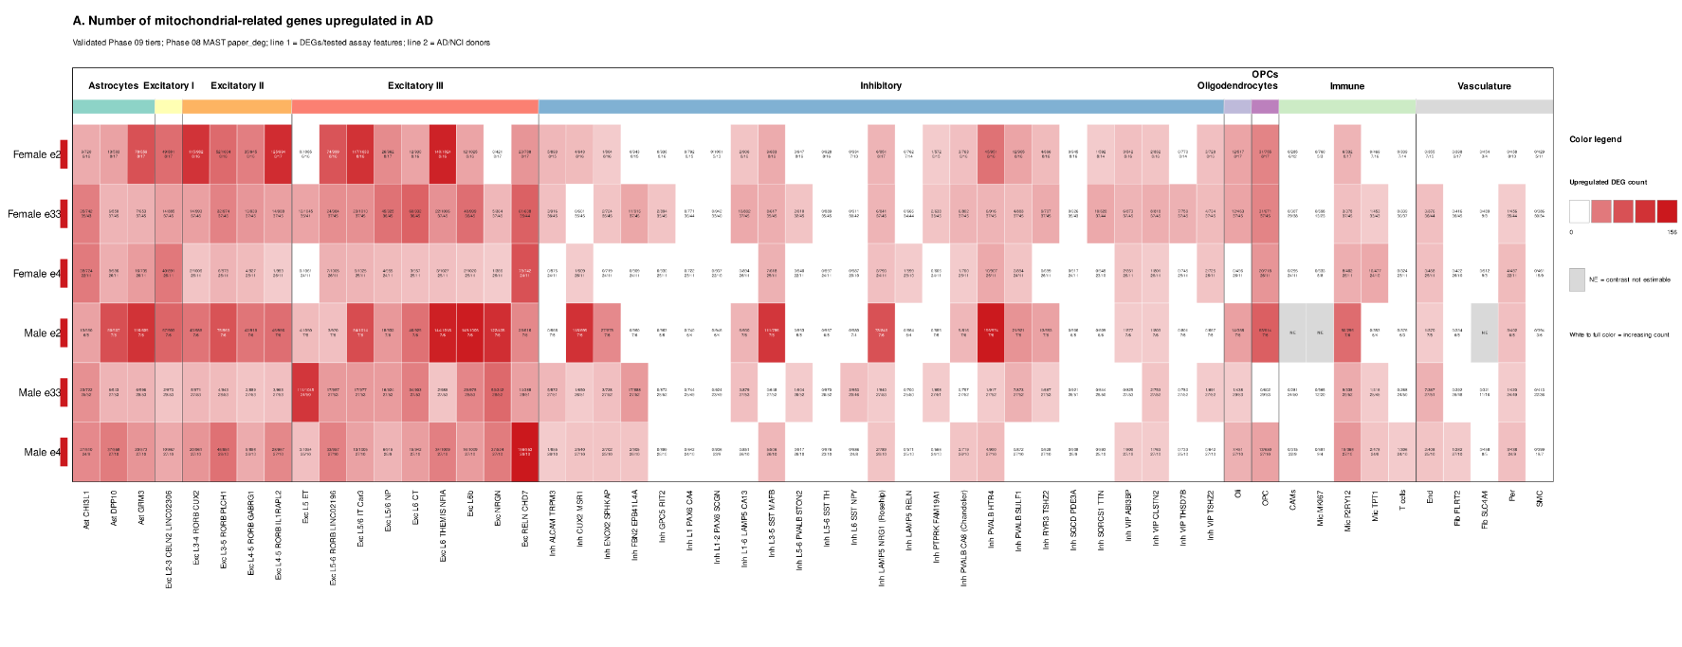
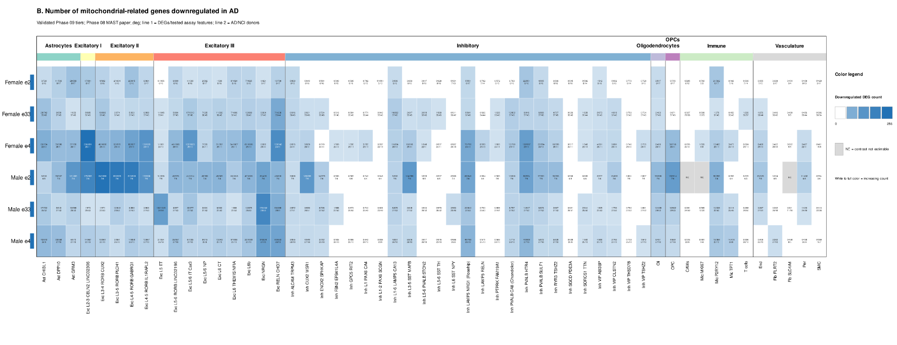
DEG Sex Analysis Results:

Slide 5
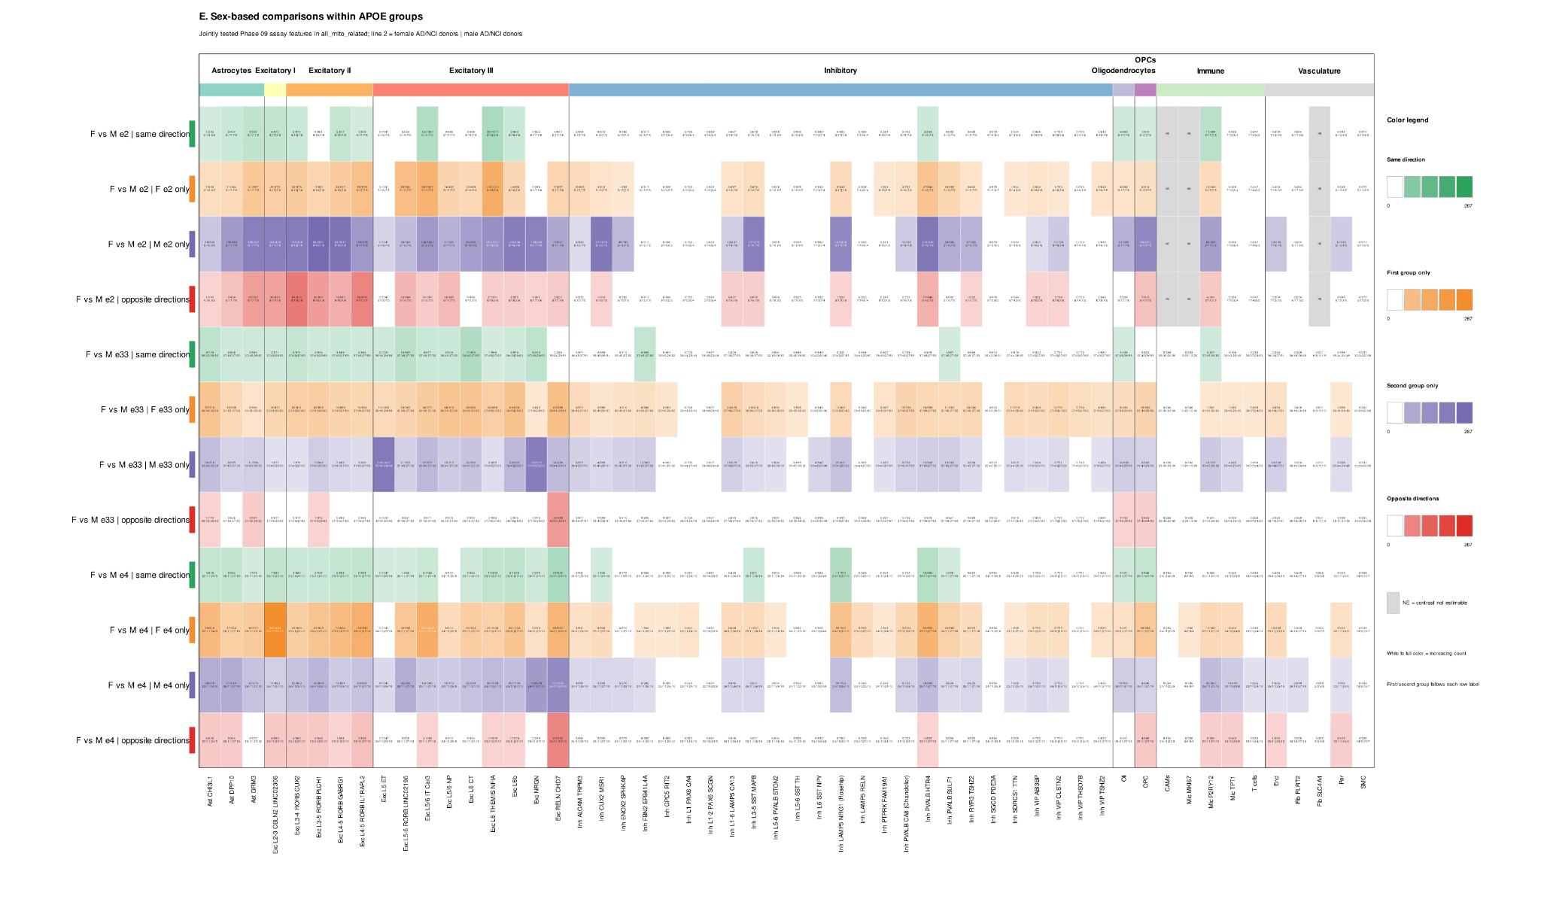
DEG Sex Analysis Results:

Slide 6
DEG Sex Analysis Results:
Strongest response in excitatory neuron
Response varies across cell type
AD-vs-NCI Response varies based on sex-APOE group

Slide 7
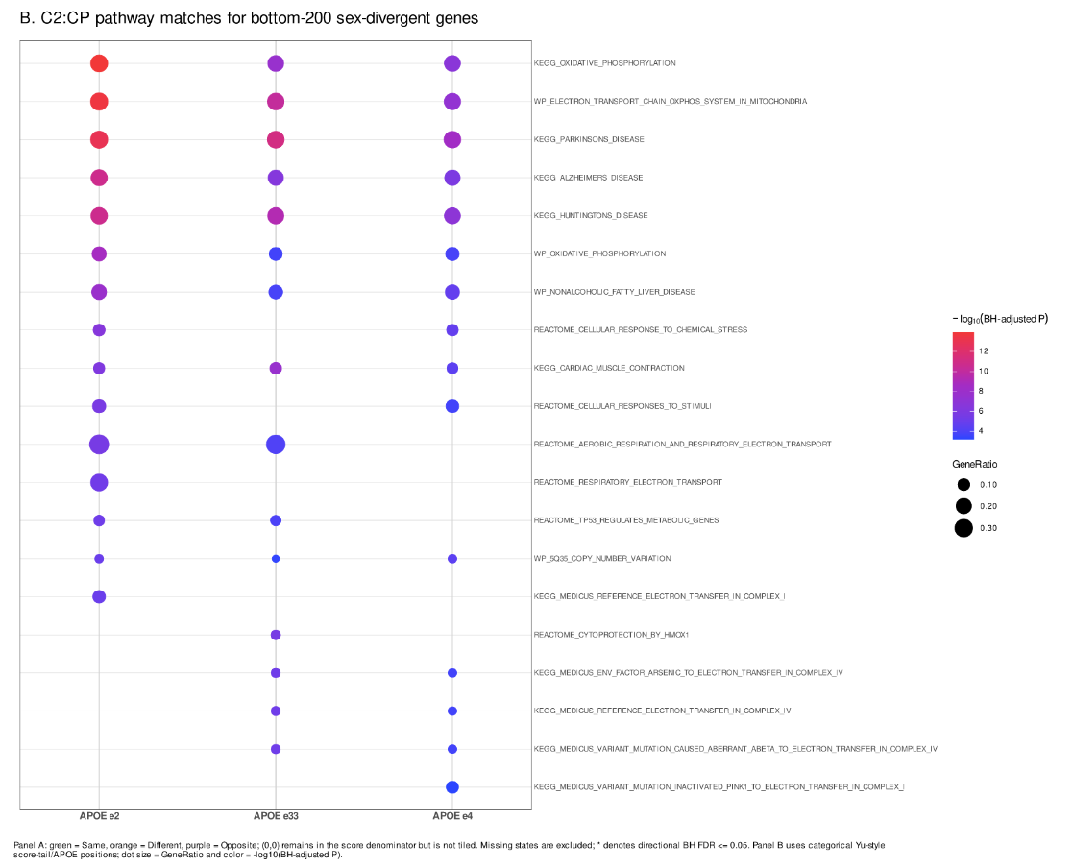
Pathway Analysis Results (sex divergence)
Notes:
OXPHOS best pathway

Slide 8
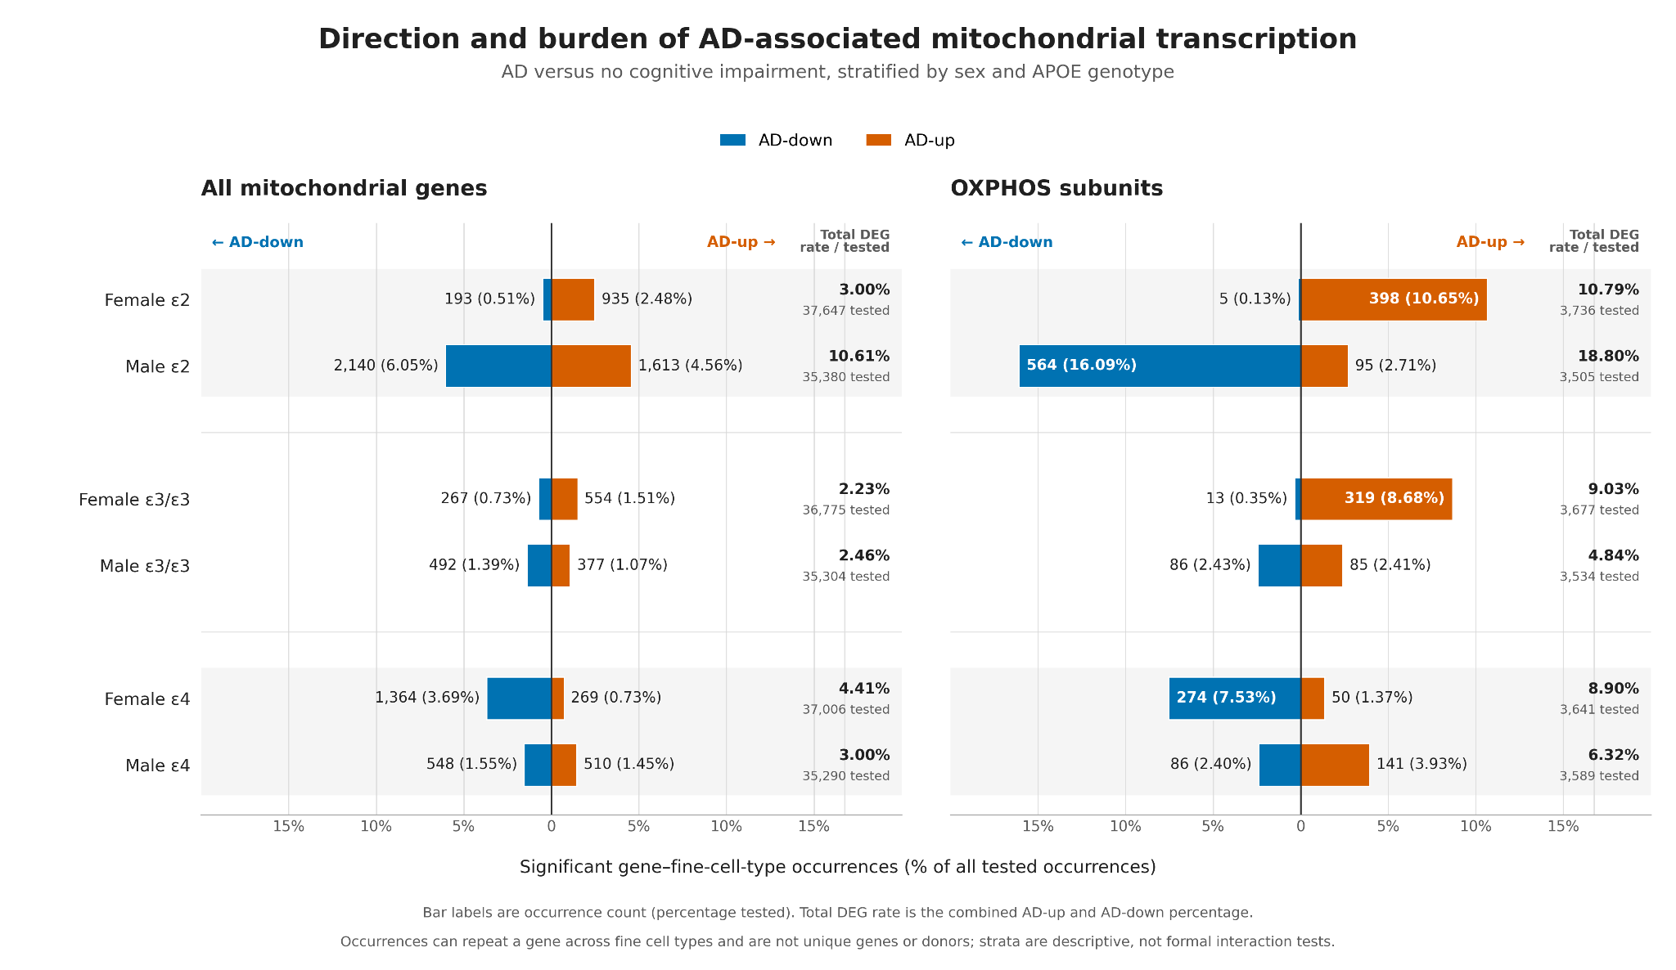

Slide 9
General conclusions:
General upregulation in female e2, but downregulation in males (sex reversal)
Mixed/inconclusive results for e3/e3 and male e4
Downregulation of female e4

Slide 10
KDA Analysis and Conclusions

Slide 11
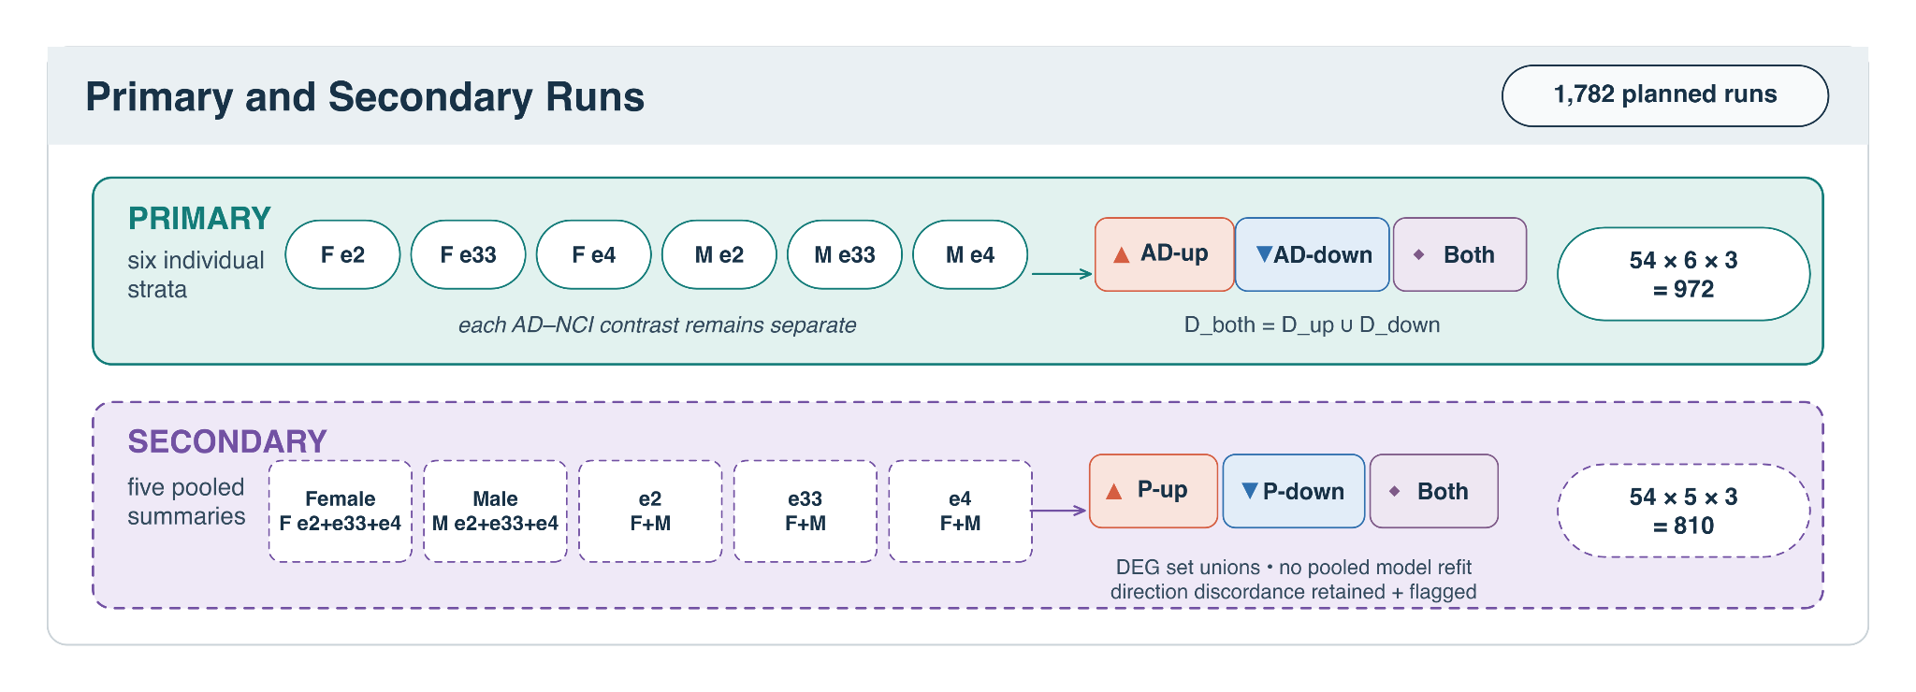
Signatures in KDA Runs
1,782 planned runs; 972 primary and 810 secondary/pooled

Slide 12
APOE regulates TUFM and ATP synthase,
In astrocytes
APOE has been returned the key driver in downregulated 20
Regulates TUFM directly or indirectly in all 20;
ATP5PB is regulated in 13, while ATP5F1A in 6
Female e2, Male e2 and Male e4
Link occurs only in astrocytes
TUFM is connected to AD (Zhong et al., 2021)

Slide 13
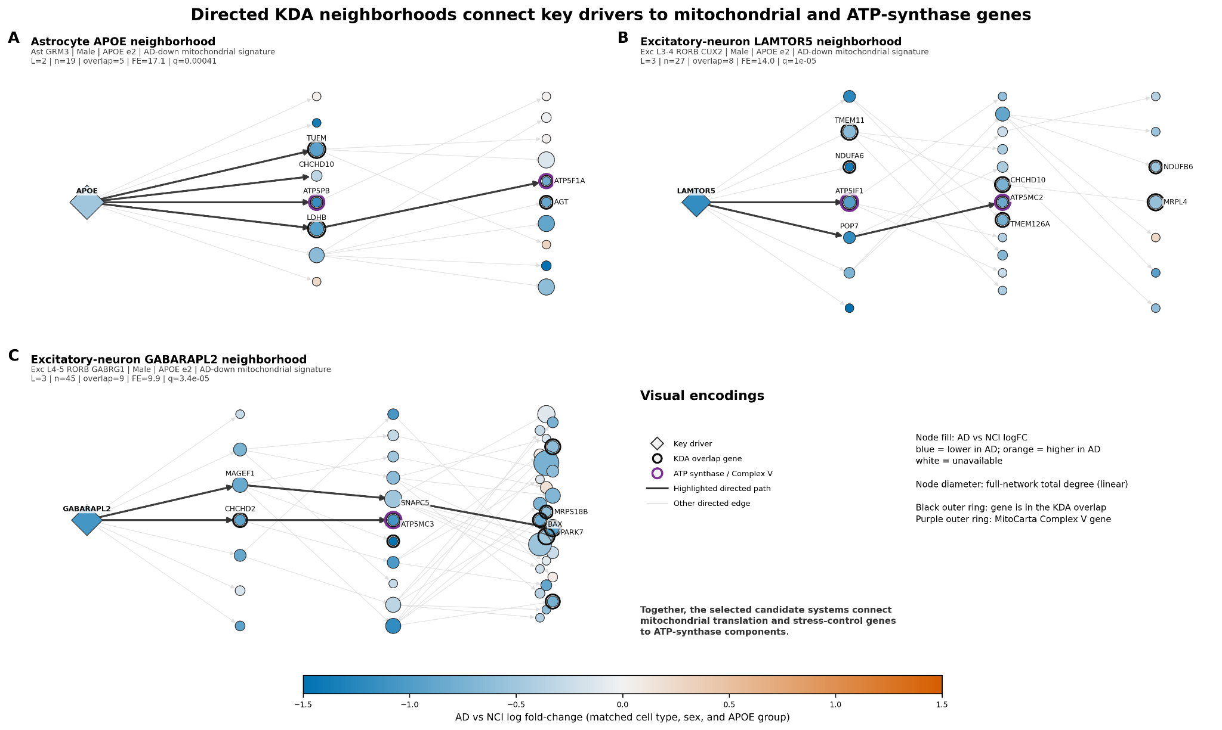

Slide 14
LAMTOR5 connects nutrient sensing to ATP5IF1
LAMTOR5 is a key subunit of the ragulator complex, involved in nutrient sensing
Key driver in 96 runs across 15 types of neurons
ATP Synthase subunits: ATP5IF1 occurs in 70 and ATP5MC2 in 56
ATP5IF1 encodes inhibitory factor subunit 1 (IF1), which prevents wasteful hydrolysis of ATP
No prior research connects either gene to AD

Slide 16
GABARAPL2 connects autophagic regulation to CHCHD2 and PARK7
GABARAPL2: 79 calls, all but 2 in excitatory neuron
CHCHD2 occurs in 66 calls (25 primary, 41 secondary) across 11 fine cell types.
PARK7 occurs in 49 calls (16 primary, 33 secondary) across 7 fine cell types.
Occur together in 42 calls, all excitatory (13 primary, 29 secondary)
A GABARAPL2-dependent pathway could improve AD phenotypes in mice (Dai et al., 2025).

Slide 18
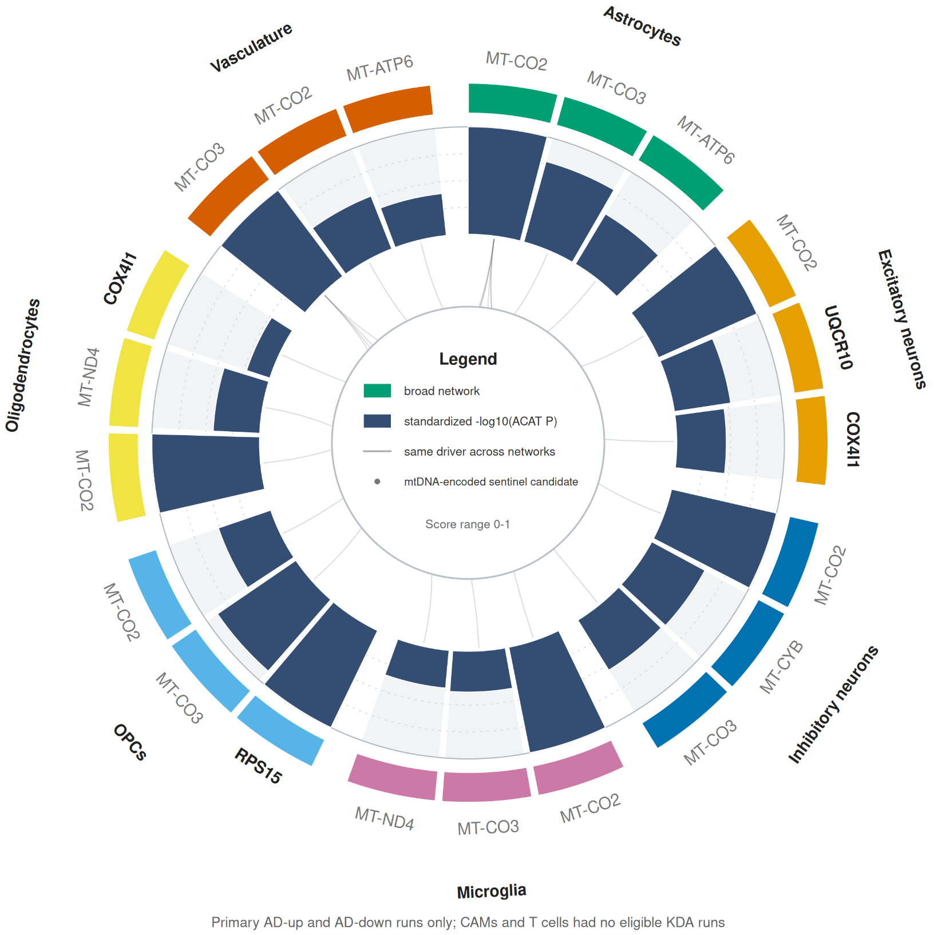
KDA Circular Figure
10 unique identified
17/21 sectors are mtDNA
MT-CO2 appears in the most broad-cell types

Slide 19
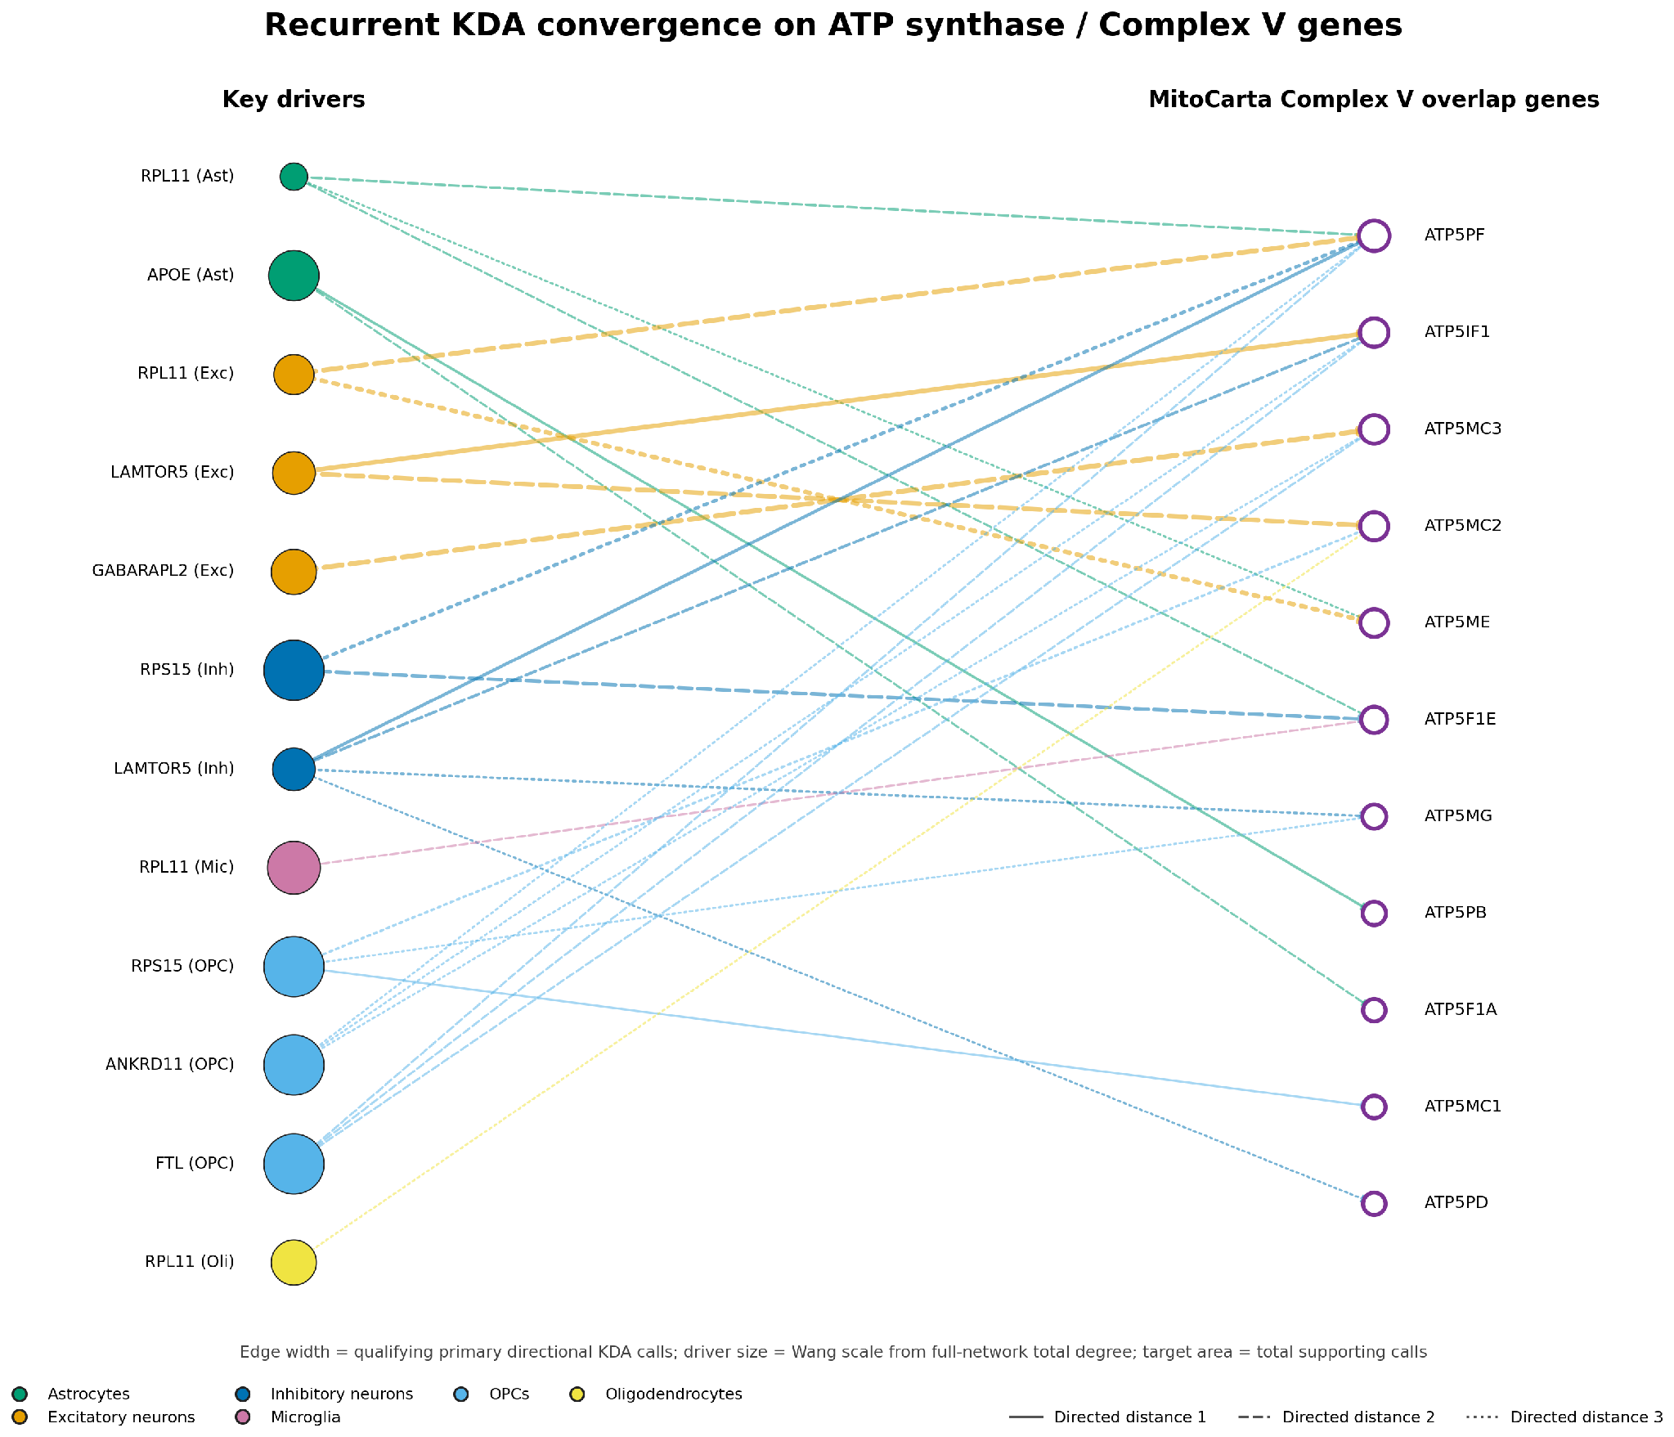
ATP Regulation

Slide 20
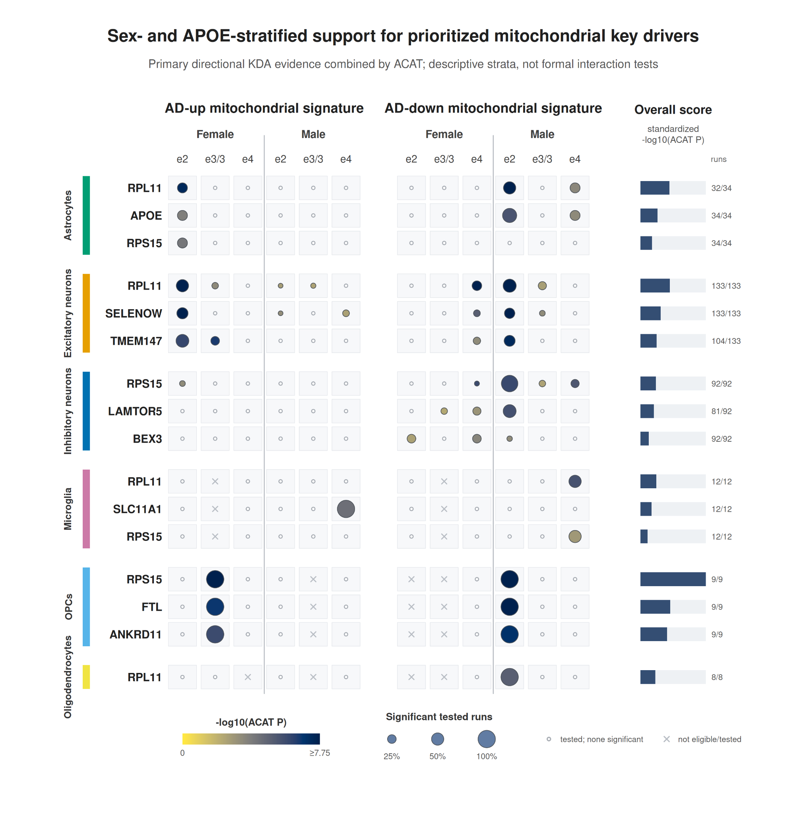
Sex-APOE analysis of relevant genes

Slide 21
Next Steps:
Look at how the identified drivers are regulated upstream
Check literature to support the conclusions made
Analyse other datasets for validation

Slide 22
Thank you :)

